Slide 1

Forecasting US Presidential Elections:
Using Mixed Effects Models
By:Perebibowei Azazi

Slide 2
Agenda
1 Overview of how the US elects presidents
2
Stylized facts about voting
3
Types of forecasting models
4
Building a fundamentals based forecasting model

Slide 3
Agenda
1 Overview of how the US elects presidents
2
Stylized facts about voting
3
Types of forecasting models
4
Building a fundamentals based forecasting model

Slide 4

US Presidential Elections
Current Number of Electoral Votes
are Decided by the Electoral College
Each state* gets electoral votes based on:
435
100
# of House of Representative Members
(1) Number of house representatives the state has, which is determined by a state’s population in
# of Senators
f
3
# of Electoral Votes for Washington DC
plus
(2) Number of senators the state has (always 2)
538
Electoral Votes in Electoral College
*Washington DC, from the 23rd amendment, gets electoral votes based on its population but no more
than the least populous state, which is currently Wyoming with 3 electoral votes.

Slide 5


51
50 states plus DC award electoral votes
Candidates win electoral
votes from a state by winning the
270
electoral votes a candidate must get to win the election
majority of votes cast in the state*
After voting is closed, we add up the votes each candidate gets per state, giving all electoral votes to the winner. The election winner is the candidate with the majority of electoral votes.
2*
Maine and Nebraska award electoral votes differently than other states (based on congressional districts)
If no candidate gets a majority (270 or more electoral votes), the election results are decided by the house of representatives (with 1 vote per state).

Slide 6

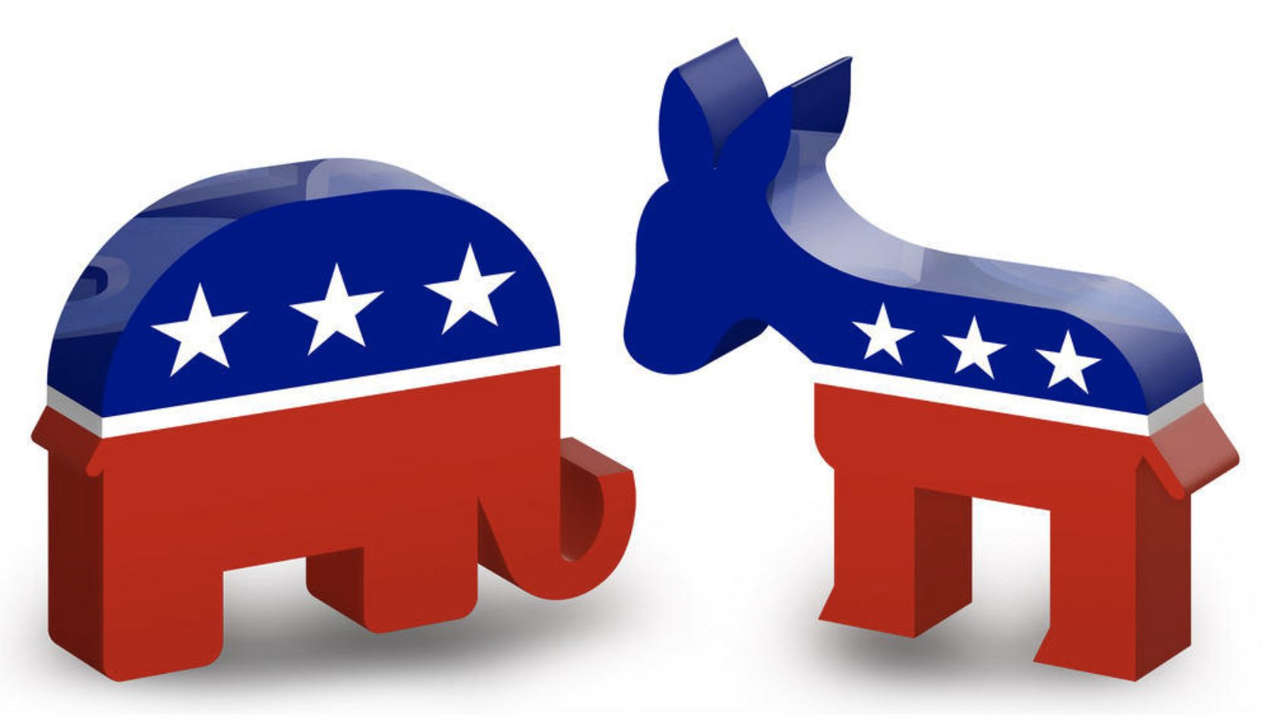
The US is a Two Party System
The electoral college is basically a winner take all system as most of the time you get all of a state’s electoral votes by winning it.
This makes it hard for third parties to matter in US Presidential elections, so we can ignore them for modeling purposes.

Slide 7

Side Note: Weird Things can Happen in the Electoral College
Because the electoral college awards electoral votes on a state by state basis, we can get weird outcomes.
It is possible for the candidate who gets the majority of votes overall i.e. wins the popular vote nationally to lose the electoral college and therefore the election.
This might sound like an edge case, but it has happened 5 times in 58 elections and 2 times in the last 5 elections (2000 and 2016)!
Splits like these, where one party wins the popular vote and the other wins the electoral college, are especially likely to occur in close races. See here and here for more information.

Slide 8
Agenda
1 Overview of how the US elects presidents
2
Stylized facts about voting
3
Types of forecasting models
4
Building a fundamentals based forecasting model

Slide 9
Stylized Facts about Voting
National + Local Economic Conditions
Polarization
Voting patterns in a given year correlate with both national and state economic conditions.
The degree to which states support one party or another has been deepening over time.
Geographic Correlation
Demographics
Similar states and those in the same region tend to vote similarly.
Voting correlates with demographics like gender, education, race, and age.
2
3
4
1

Slide 10
Stylized Facts about Voting
National + Local Economic Conditions
Polarization
Voting patterns in a given year correlate with both national and state economic conditions.
The degree to which states support one party or another has been deepening over time.
Geographic Correlation
Demographics
Similar states and those in the same region tend to vote similarly.
Voting correlates with demographics like gender, education, race, and age.
2
3
4
1

Slide 11
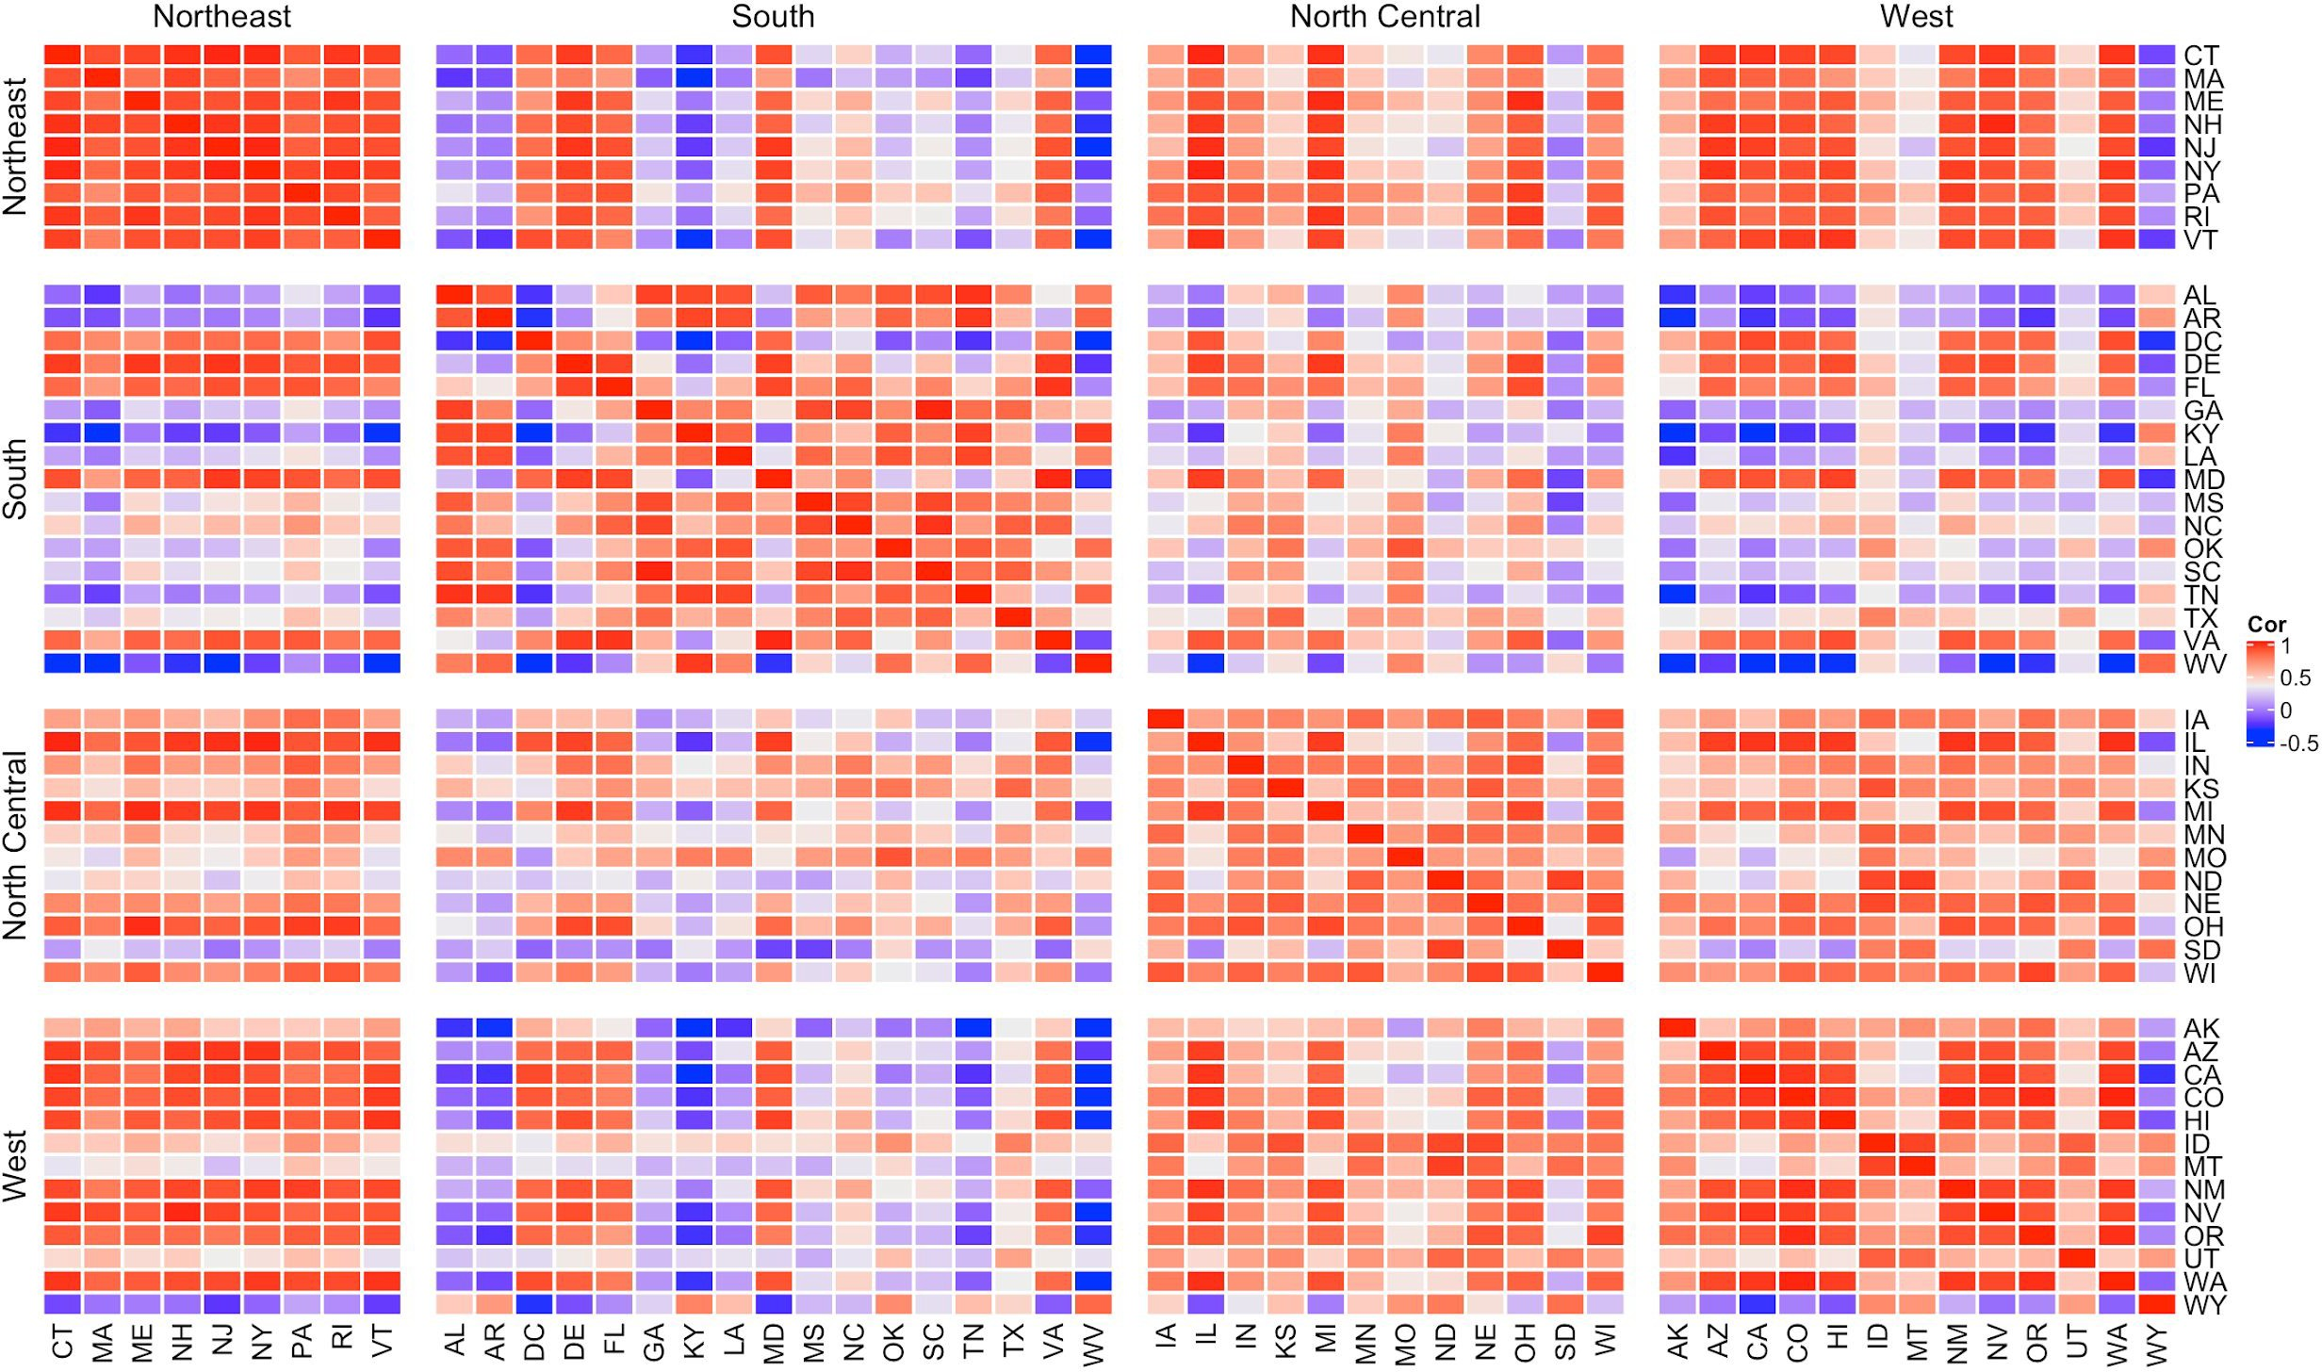
High Correlation Across States in a Region

Slide 12
Stylized Facts about Voting
National + Local Economic Conditions
Polarization
Voting patterns in a given year correlate with both national and state economic conditions.
The degree to which states support one party or another has been deepening over time.
Geographic Correlation
Demographics
Similar states and those in the same region tend to vote similarly.
Voting correlates with demographics like gender, education, race, and age.
2
3
4
1

Slide 13
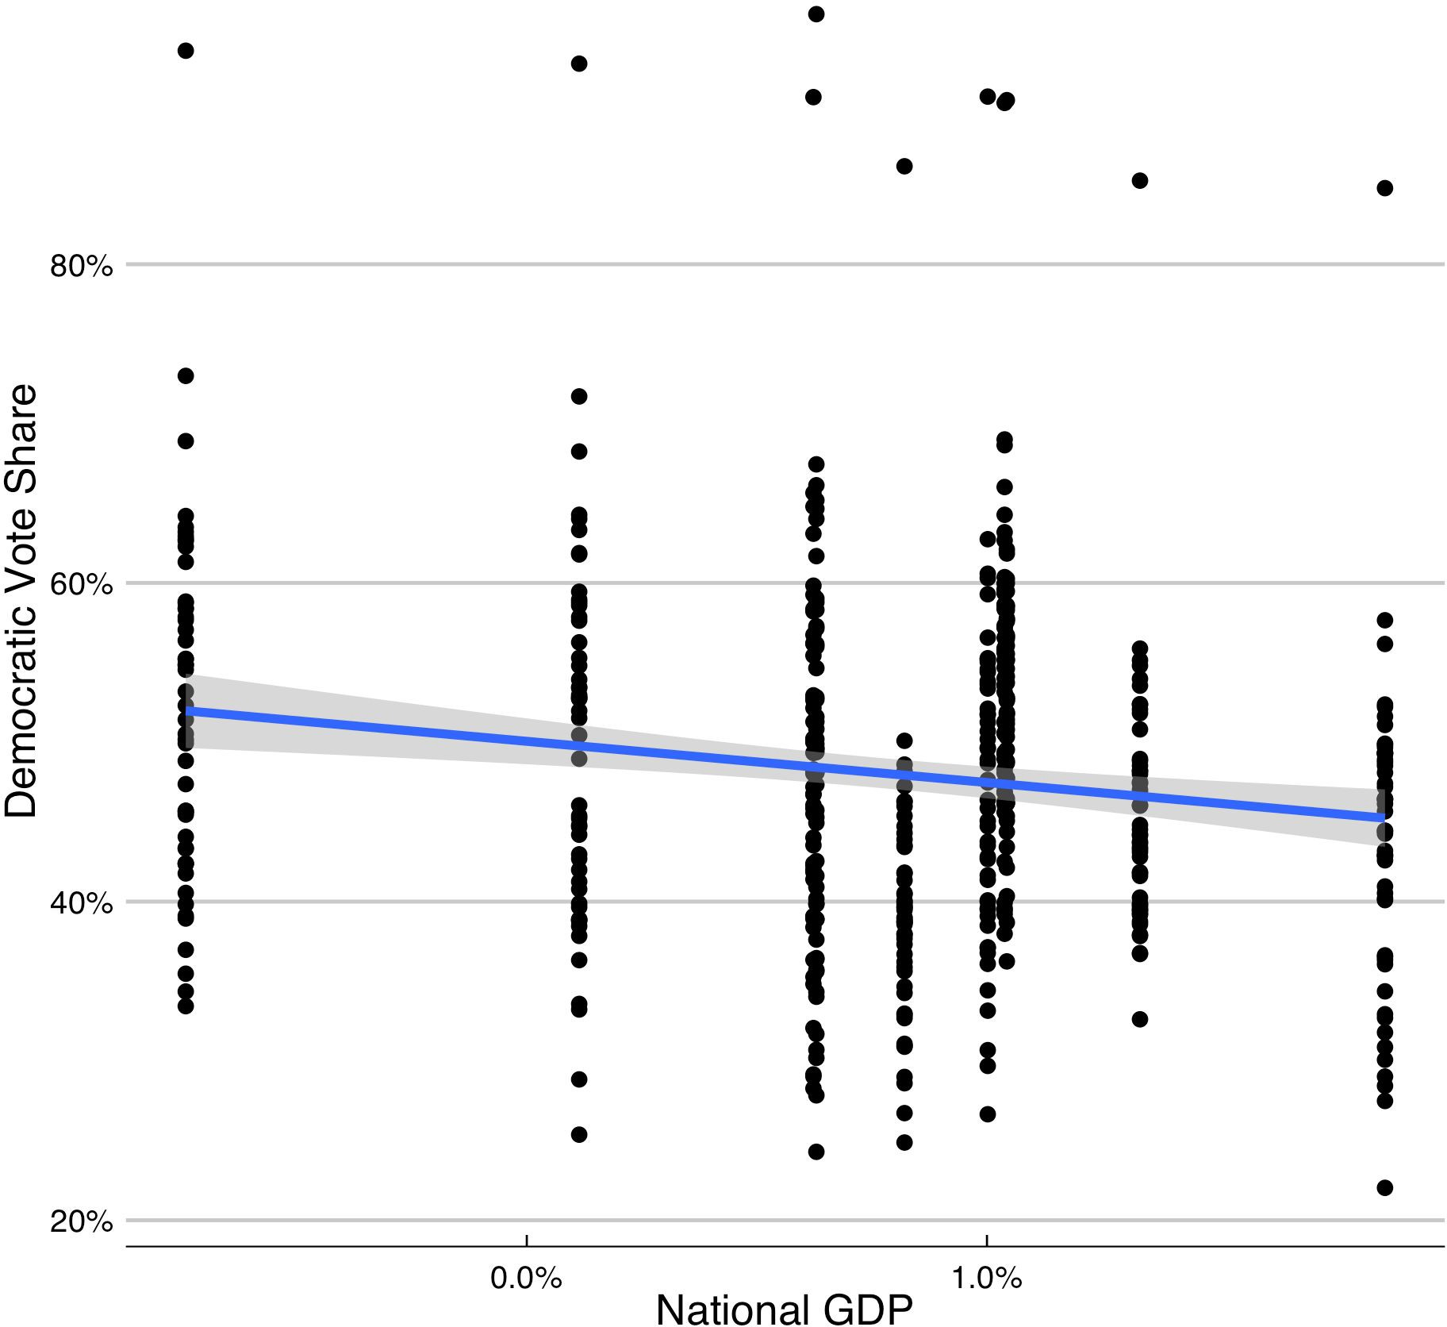
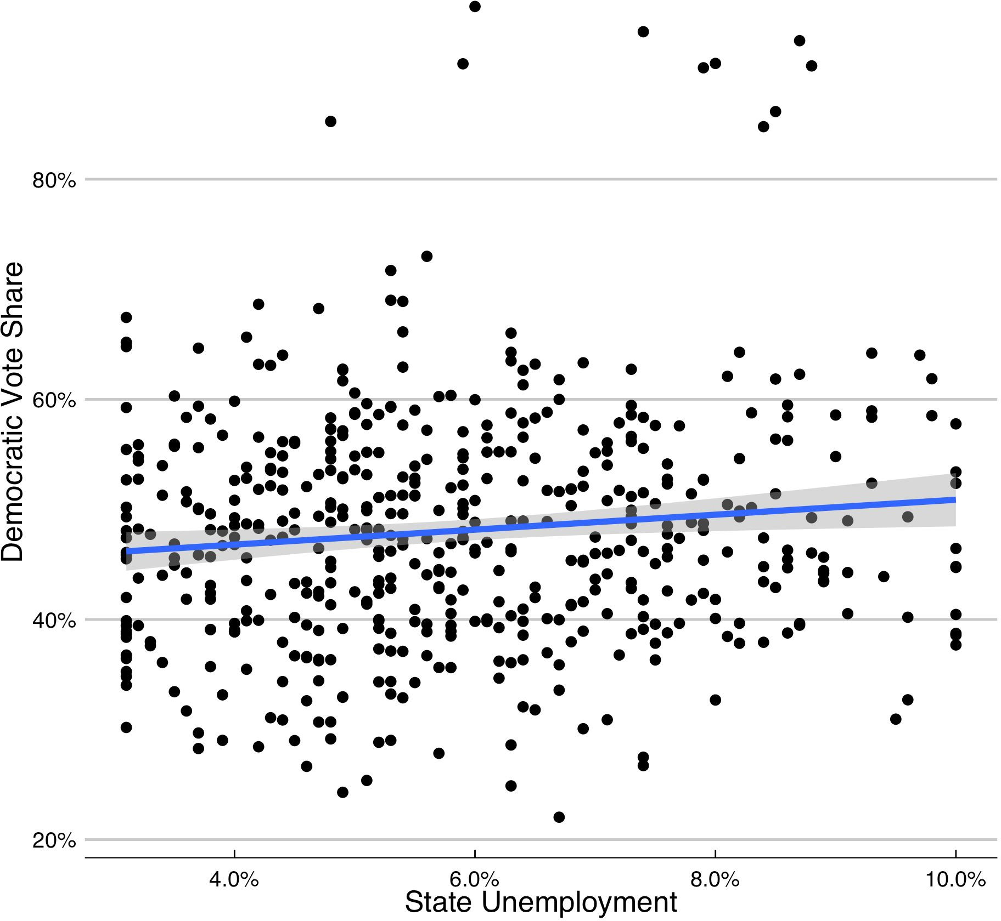
National & State Economic Conditions Matter

Slide 14
Stylized Facts about Voting
National + Local Economic Conditions
Polarization
Voting patterns in a given year correlate with both national and state economic conditions.
The degree to which states support one party or another has been deepening over time.
Geographic Correlation
Demographics
Similar states and those in the same region tend to vote similarly.
Voting correlates with demographics like gender, education, race, and age.
2
3
4
1

Slide 15
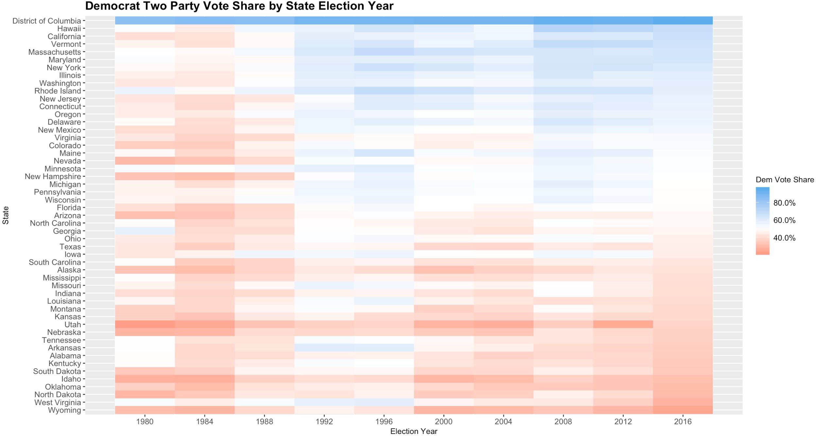
Now Red States are Redder & Blue States are Bluer

Slide 16
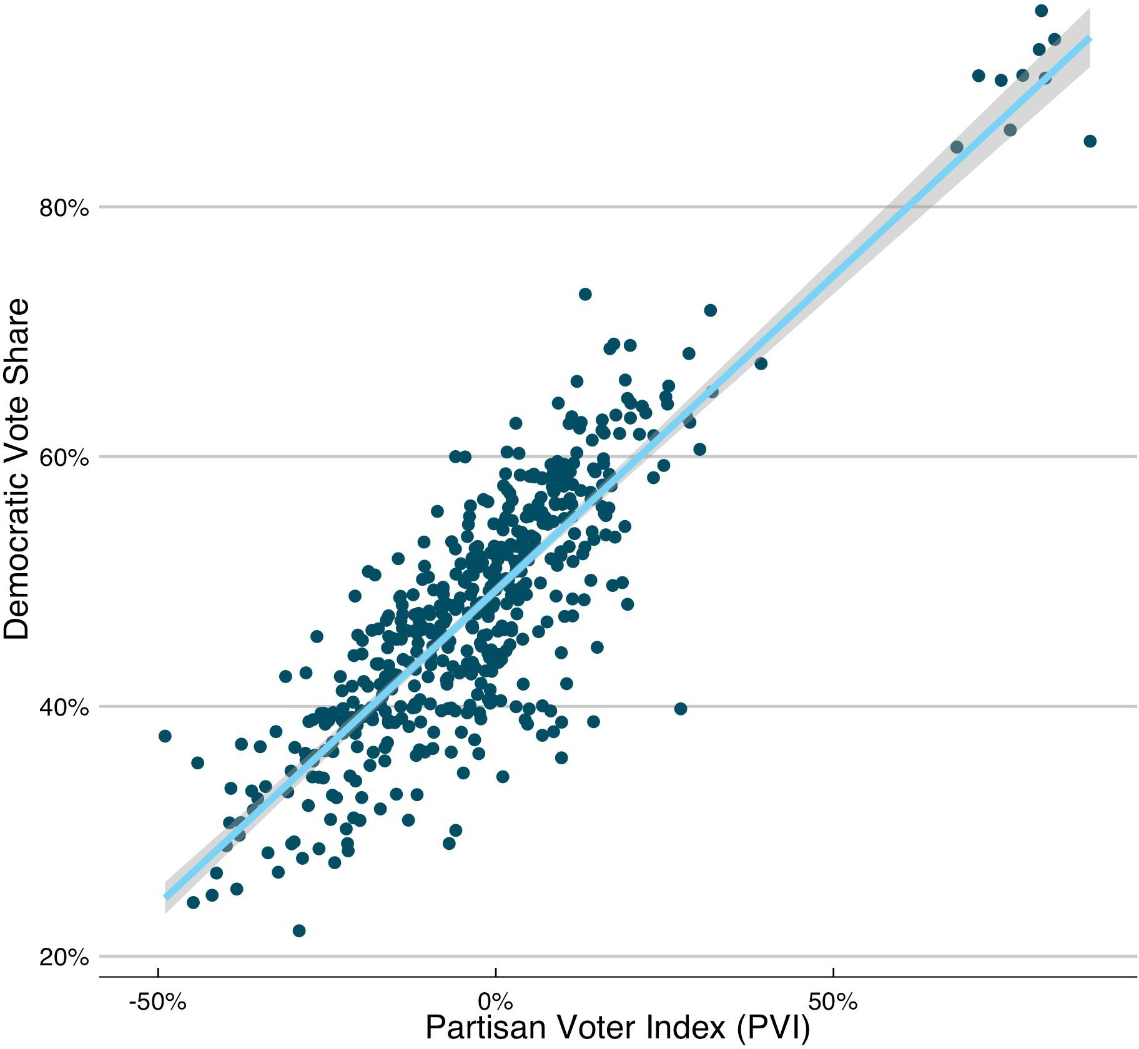
Key Variable: Partisan Voter Index (PVI)
PVI_{state, year} = (Dem Vote Share_{state, year} - Rep Vote Share_{state, year}) - (Dem Vote Share_{national, year} - Rep Vote Share_{national, year})
Calculate predictor using a mix of PVI in the past two elections before a given election year
Ex: PVI predictor for 2016 is a 75%, 25% mix of PVI in 2012 and 2008; this reduces overﬁtting to last election
This metric intuitively captures how much more Democratic or Republican leaning a state has been recently than the nation as a whole and is a strong predictor of future voting patterns.

Slide 17
Stylized Facts about Voting
National + Local Economic Conditions
Polarization
Voting patterns in a given year correlate with both national and state economic conditions.
The degree to which states support one party or another has been deepening over time.
Geographic Correlation
Demographics
Similar states and those in the same region tend to vote similarly.
Voting correlates with demographics like gender, education, race, and age.
2
3
4
1

Slide 18
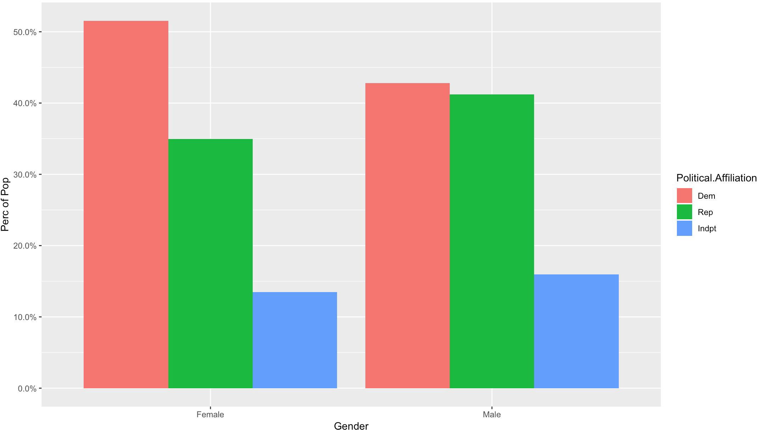
Women are More Likely to Vote Democratic

Slide 19
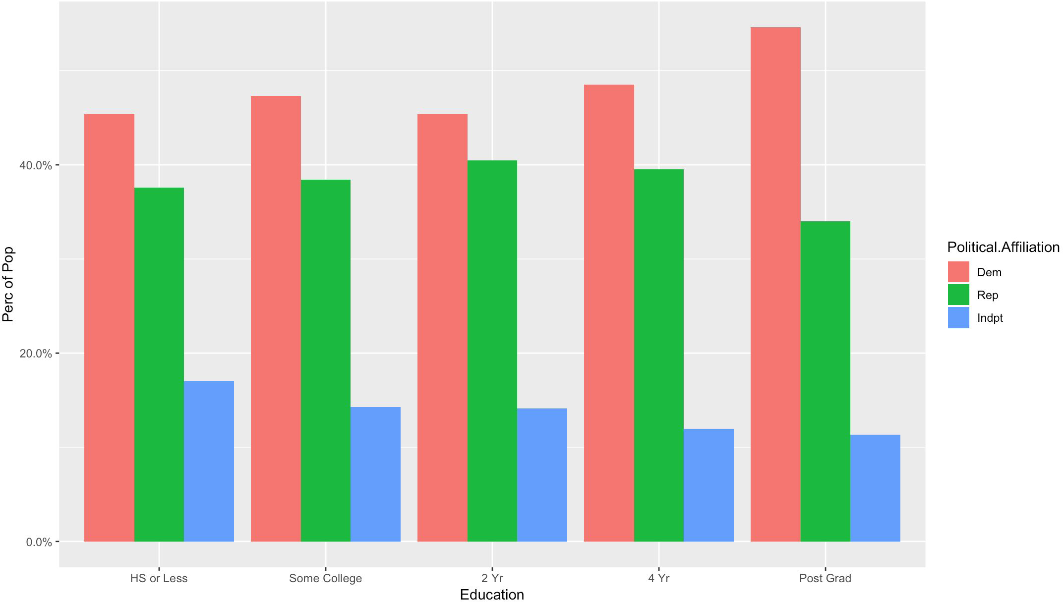
Voting Democratic is Correlated with Education

Slide 20
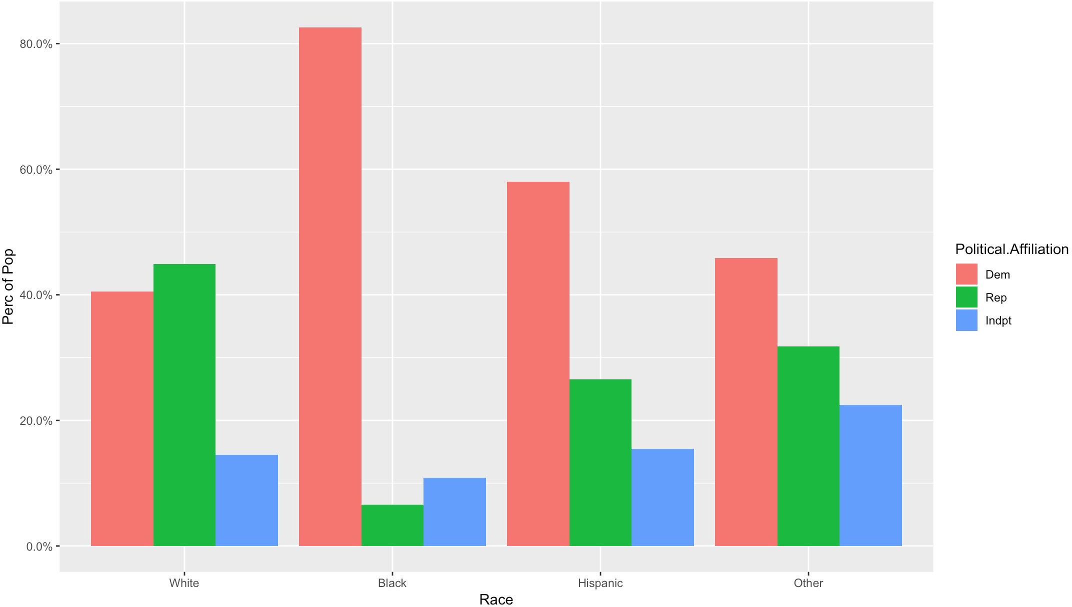
White Voters are Less Likely to Vote Democratic

Slide 21
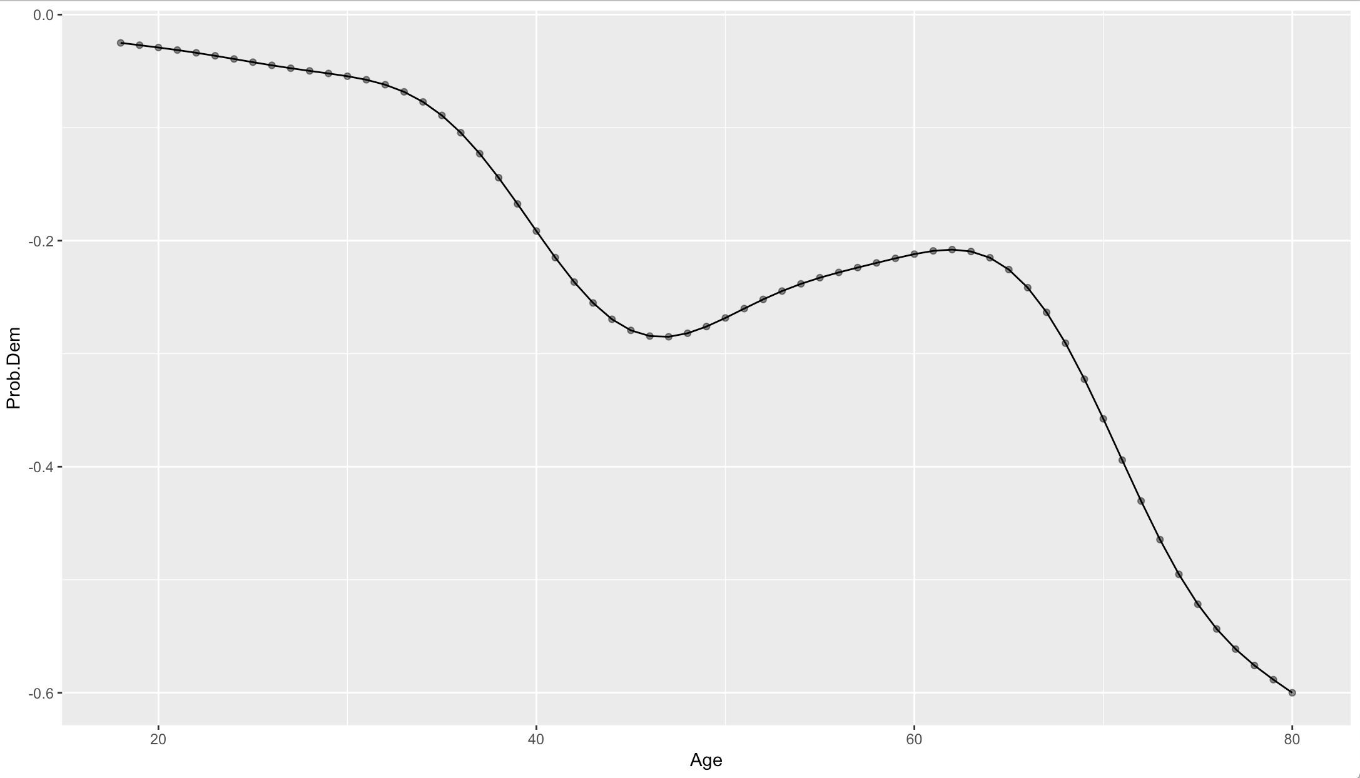
Younger Voters Tend to Vote Democratic

Slide 22
Agenda
1 Overview of how the US elects presidents
2
Stylized facts about voting
3
Types of forecasting models
4
Building a fundamentals based forecasting model

Slide 23
Types of Forecasting Models
Fundamentals Based
Polls Based
Fundamentals + Polls Hybrid
Assume elections are based on things like the economy, past voting history, incumbency, approval, etc.
Use national and state polls prior to the election to reveal what voter preferences are.
Idea is to combine fundamental predictors and polls together to get the merits of both.
What They Are
Historically there is not that much data since there have been few elections. As a result fundamentals based models tend to overﬁt.
Generally performs better than fundamentals based models. But polls have issues:
Empirically this method seems to perform the best.
Pros / Cons
Herding: polls can try to copy one another
House eﬀects: polls can be biased towards one party
Sparsity: certain states might see few (or zero) polls

Slide 24




Fundamentals Based Models
Data Sources
We will build a fundamentals based
model together because:
MIT Election Lab
By State Election Results
Polling data is hard to ﬁnd
Fundamental models are simpler
US Elections
Project
Voter Turnout
They provide a good benchmark
UCSB President Approval Data
Approval Data
We can construct one that is historically
quite accurate
IPUMs CPS
Survey Data
Demographic Data
We will start with a cleaned data set that puts several sources together for
FRED Economic
Database
National + State Economic Data
simplicity.

Slide 25
Agenda
1 Overview of how the US elects presidents
2
Stylized facts about voting
3
Types of forecasting models
4
Building a fundamentals based forecasting model

Slide 26
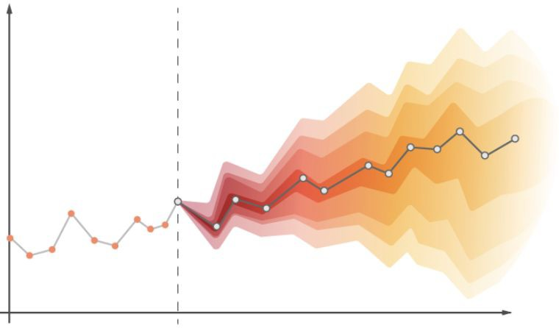
Building the Model
Key Principles
Ignore Candidate Speciﬁcs (mostly irrelevant and hard to quantify) ✔
Because the US is a two party system, we will ignore third parties ✔
Make probabilistic forecasts to capture uncertainty in model predictions ✔
We will focus on predicting Republican vote shares without loss of generality ✔
High Level Steps
Build a model to predict vote shares in each state to determine which party will win (Republican or Democrat)
Build a model to estimate errors / random noise in voting to account for uncertainty in forecasts
Based on the model and error estimates, decide the winner of each state and therefore the number of electoral votes each party gets to ﬁnd election winner
Repeat steps (1) through (3) many times to simulate the probability of each party winning

Slide 27
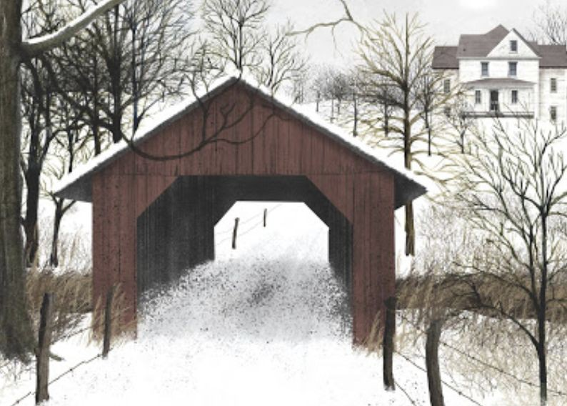
To R We Go!
Now let’s go to R to build a fundamentals based forecasting model for the 2020 election.

